Slide 1
Working with Duke Research Administration and Central Offices
Presented by:
Dr. Denise Y. Wynn, Administrative Director, Department of Medicine-Research Administration
May 28, 2025

Slide 2
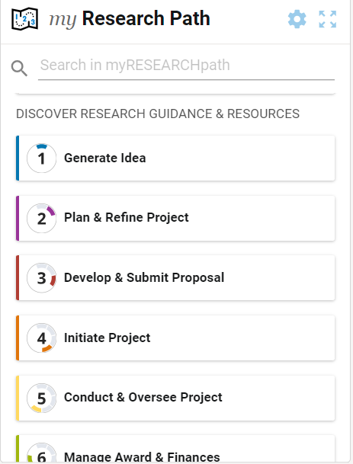
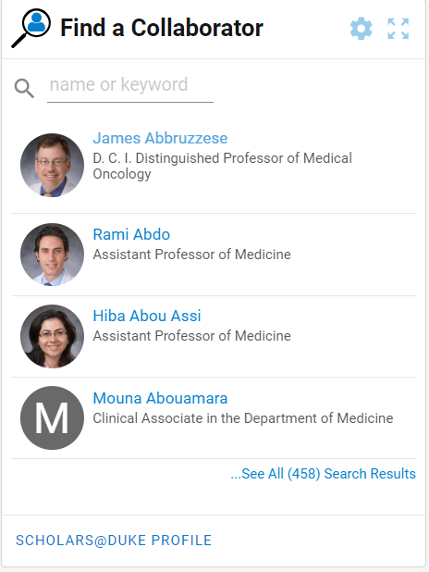
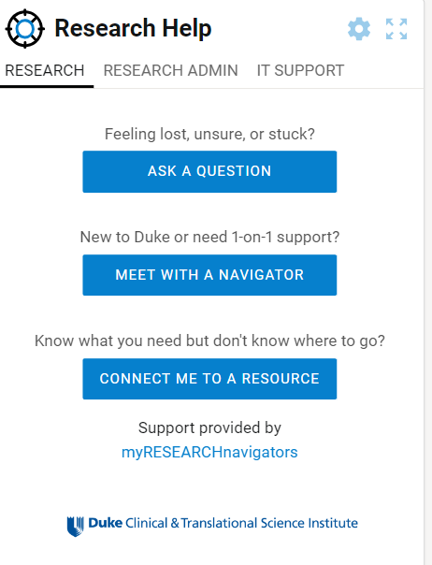
Where to Find Resources
On MyResearchHome (MRH)
Find Processes and Procedures
Find Collaborators using Keywords or Name
Ask Questions & Connect

Slide 3

Newsletter
Duke OPSD sends out emails with the latest funding opportunities

Slide 4
Offices who Can Help
Office of Research Development
Facilitates development of complex research grant proposals led by faculty at the Duke School of Medicine
https://medschool.duke.edu/about-us/faculty-resources/office-research-development/services/complex-research-grants
Office of Campus Research Development
Provides proposal development services to help Duke faculty and the broader research community submit high-quality proposals
Support for multi-disciplinary and multi-institutional proposals
Proposal Development Consultation
https://research.duke.edu/ocrd/

Slide 5
Things to Consider before Applying
Does Duke faculty appointment percentage meet award mechanism and Duke appointment minimum effort requirements?
Individuals who are not regular rank faculty must request School of Medicine approval to submit a proposal as PI. (PI Eligibility Policy & Procedure)
F&A waiver may be required and needs SOM approval
SOM approval needed at least 15 business days before internal review deadline
4. Contact your Grant Manager within your department before you start

Slide 6
Proposal Templates
Abstract
Authentication of Key Biological and Chemical Resources
Biosketch (includes new form and guidance for proposals due on or after 1/25/2022)
  Example Biosketch
Budget Justification (Detailed)
Consortium/Contractual Arrangements
Data Management and Sharing Plan
Equipment
Facilities and Other Resources: Overall
Facilities and Other Resources: Admin Core
Facilities and Other Resources: Core
Facilities and Other Resources: Project
  Facilities and Resources Repository (access boilerplate language and contacts for facilities and resources to potentially support the project)
Introduction
Multiple PI Leadership Plan
Project Narrative
References
Research Strategy: Overall
Research Strategy: Admin Core
Research Strategy: Core
Research Strategy: Project - no clinical trial
Research Strategy: Project - with clinical trial
Resource Sharing Plan
Select Agent Research
Specific Aims
Vertebrate Animals

Slide 7
School of Medicine
Intent to Submit (I2S)

Slide 8
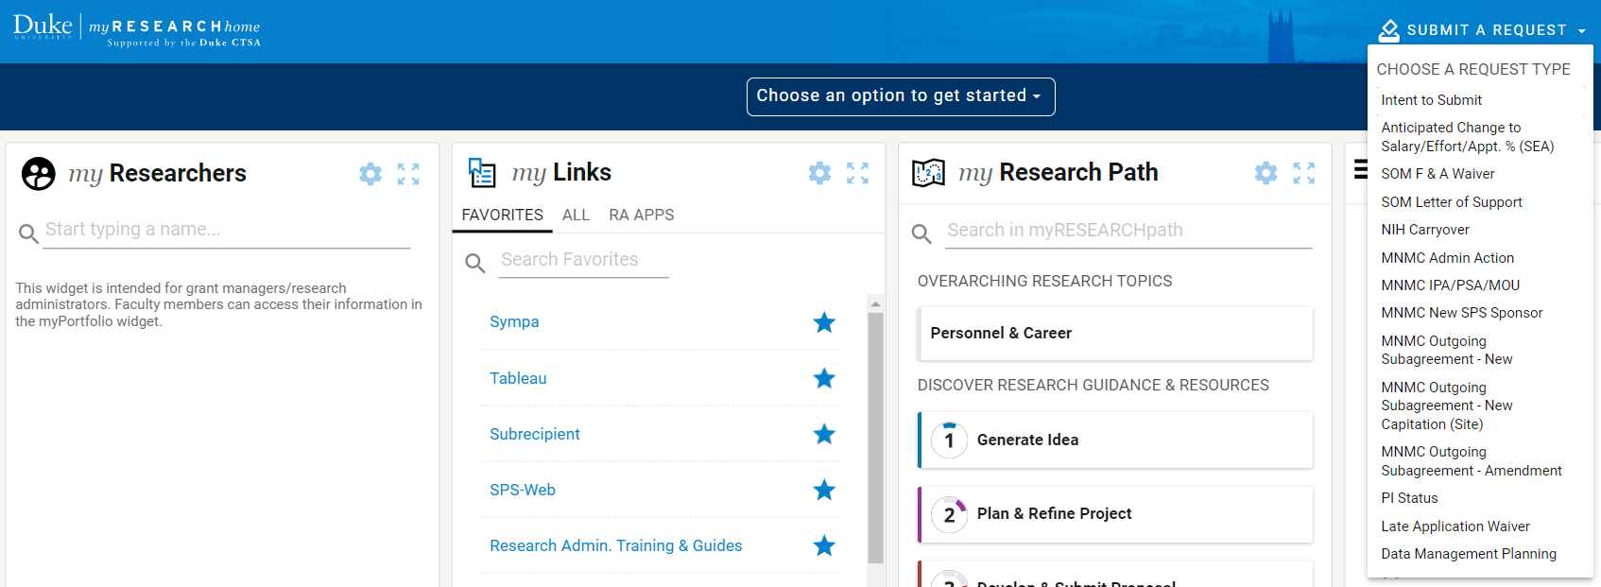
Intent to Submit (I2S) on MRH

Slide 9
How to Begin a Proposal
Submit an Intent to Submit (I2S) AND the Proposal Intake Form early
At least 15 business days prior to sponsor submission deadline for large proposals, such as proposals with subcontracts or international components (e.g. Federal contracts).
Complex proposals such as complex center grants, institutional training grants and cooperative agreements should be done earlier.
Check your department’s internal deadlines

Slide 10
Importance of I2S and Proposal Intake Form
Intent to Submit (I2S)
alerts Department of Submission
Proposal Intake Form
Has Detailed Information for Submission
Information can be pushed into Sponsored Projects System (SPS) Record

Slide 11
Department of Medicine Process

Slide 12
How to Begin a Proposal
Submit an Intent to Submit (I2S) AND the Proposal Intake Form early
At least 60 business days prior to sponsor submission deadline for large proposals, such as proposals with subcontracts or international components (e.g. Federal contracts).
4-6 months prior to sponsor submission deadline for complex proposals such as complex center grants, institutional training grants and cooperative agreements
DoM-RA Proposal Review and Submission Procedures
Use the Proposal Calculator to Help with Deadlines

Slide 13
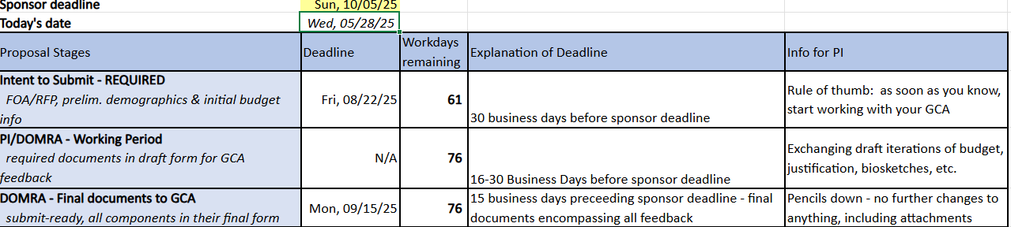
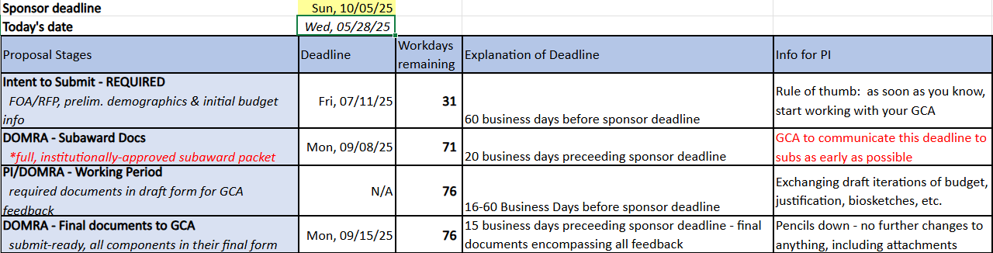
Proposal Calculator
Standard Proposal
Complex Proposal & Proposals with Subrecipients

Slide 14
Proposal Questions

Slide 15
Key Personnel
The Program Director(s) (in case of multiple PD/PIs), and any other individuals whose contributions are critical to the development, management, and execution of the Research Training Program Plan in a substantive, measurable way (whether or not salaries are reimbursed) should be included as senior/key persons.
Things to Consider:
Senior and Key Personnel are specifically and uniquely important to the project and have a specific skill set that is difficult to replace.
The individual (and Duke) is responsible for fulfilling the role AND the effort.
Changes to the Senior and Key Personnel designations won’t happen with the click of a button.
https://myresearchpath.duke.edu/updates/duke-guidance-appropriate-designation-senior-and-key-personnel-sponsored-projects
Notes:
Senior and Key Personnel are specifically and uniquely important to the project and have a specific skill set that is difficult to replace. If replacements for the individual would be readily available, it is appropriate to question the designation. Typically, Senior and Key Personnel designations apply to those in a PI, co-PI, multi-PI, or Program Director roles who have a doctoral or other terminal professional degree. If the individual’s skill sets and contribution to the project aren't considered irreplaceable to the extent that their absence from the project would call into question the team’s ability to carry out the project activities, then it may be wise to reconsider the Senior/Key designation.
The individual (and Duke) is responsible for fulfilling the role AND the effort. When proposing effort to a sponsor, we should verify and confirm that the role and effort are reasonable and sustainable. Proposing effort levels that would be challenging to meet can put the personnel (and Duke) in a difficult situation and create unrealistic expectations putting us all at risk. Moreover, the assigned Senior/Key roles - along with corresponding effort levels - require management throughout the life of the project to ensure commitments are met.
Changes to the Senior and Key Personnel designations won’t happen with the click of a button. Senior and Key Personnel are maintained in project documentation and reported on throughout the life of the project. Depending on the sponsor's terms and conditions, changing this designation may require more than Duke approval. A sponsor may require prior written approval which means Duke's internal review and authorization of the request that explains the reason for the change, provides sufficient scientific justification to support the request, and adequate assurance that the change will not compromise the project work and outcomes.

Slide 16
Human Subjects Involved?
Will human subjects be used at any time during the project period, either at Duke or at any participating subrecipient and/or site location? Does the proposed research involve human specimens and/or data? Will human embryonic stem cells be used at any time during the project period? Will human fetal tissue, cord blood, etc. obtained from elective abortions be used at any time during?

Slide 17
Human Subjects Continued
Is this study using a drug or is it chart review where the subjects have already
consented to the use of their deidentified samples?
If yes to study drug, is it oral or infusion?
Where will the procedures/tests be performed?
Which tests will we need and are they local or central labs? Will need CPT (Current Procedural Terminology) or LAB code if available and list the lab(s) we are using.
What other procedures may be performed by the study team (i.e. screening, data entry, subject surveys, follow-up phone calls)?

Slide 18
Human Subjects Questions
What other departments or Core Services will we need (i.e. IDS, Radiology, Pathology, Ophthalmology, DEPRU)?
Will we need to use Pickett Road for any reason?
Will the subject samples be stored or shipped?
What are the stipends? Are we using ClinCard? Who will be creating the Informed Consent Form for the subjects?
Who is the monitor? If not done by sponsor, CQMP (Clinical Quality Management Plan) will need added to budget (effort).

Slide 19
Human Subjects Continued
How much time does the PI invest in meetings and talks with the sponsor to get this study going?
How much CRC (Clinical Research Coordinator)/data entry time will be required to get quotes, have meetings, and set up site selection visits? Schedule meeting with lead CRC to determine total effort per visit.
How much regulatory time is needed to get protocol approval?
Assistant Research Practice Manager (ARPM) effort will be added to each budget with human subjects

Slide 20
Budget Tips
Complete the budget early to avoid delays
Personnel added to the budget must be approved by their Home Department twice (2X)
1.For salary approval
2.When the proposal is routed
Assistant Research Practice Manager (ARPM) effort will be added to each budget with human subjects
Changing the budget close to the deadline increases the risk of your application not being submitted.
Let’s look at an example (1 PI, 8 Investigators, 6 other personnel)

Slide 21
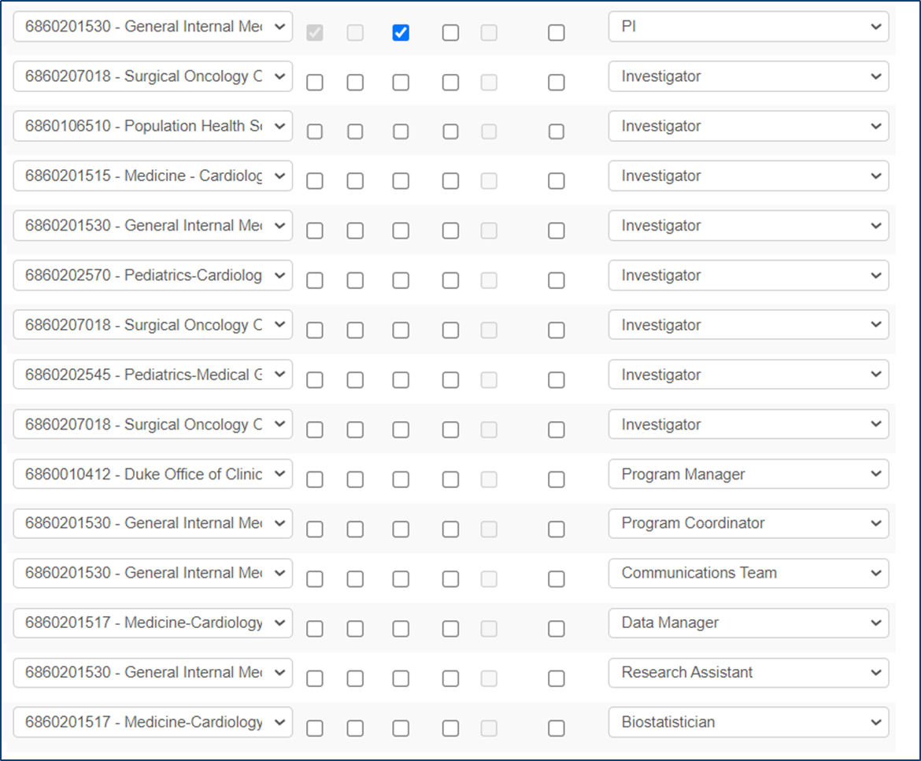
Personnel Approvals
For personnel outside of Medicine, the home department has to approve each person.
For example: Surgery, Population Health, Pediatrics, DOCR need to approve the people listed from their departments
Additionally, this proposal will need to be approved through all of those departments, and then back to Medicine PRIOR to going to ORA

Slide 22
Submission to ORA

Slide 23
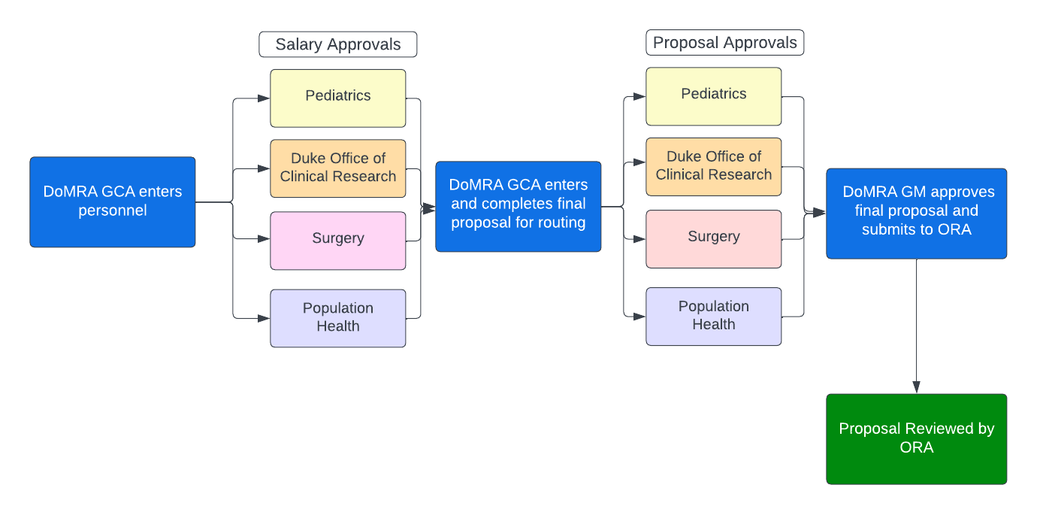
Proposal Flow

Slide 24
Let’s Look at How Long it takes to process a Proposal
Sponsor: NIH
Sponsor Deadline: 10/5/2025
Intent to Submit
Proposal Development
Institutional
Approvals
Proposal Submission

Slide 25
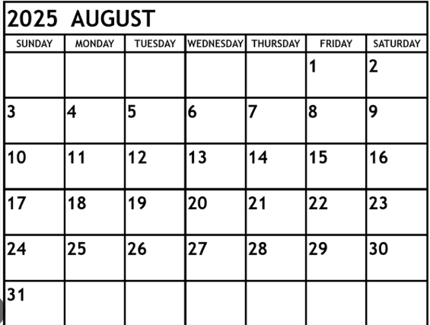
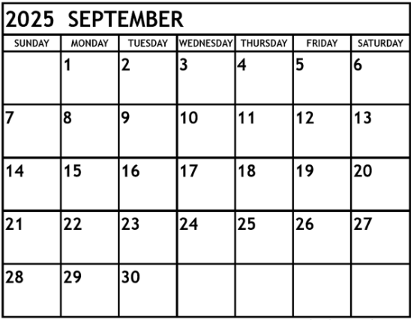
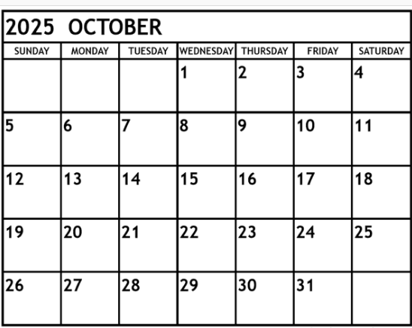
Proposal Deadline Example
Submit I2S
Final Docs to DoM-RA
Route to ORA
ORA Review
August 22,2025
Sept 29, 2025
Sept 22, 2025
Sept 15, 2025
Submit to Sponsor
October 6, 2025

Slide 26
Proposal Application TIPS
No Hyperlinks allowed in documents for Grants.Duke Submissions
Key Personnel (NIH Roles Senior Key Person)
All margins and page limits should be followed per Sponsor Guidelines
File names should be under 50 characters
Data Management Plans Guidance
F&A Waivers, Cost-Sharing, and PI Status must be approve prior to routing.
Common Errors and How to Avoid Them

Slide 27
Biosketches
Use SciENcv
Make sure to list VA appointments
Figures, tables (other than those included in the provided format pages), or graphics are not allowed in the biosketch. Do not embed or attach files (e.g. video, graphics, sound, data).
Personal Statement should be related to specific application
You may provide a hyperlinked URL to a full list of your published work.
No other hyperlinks allowed for Grants.Duke Submissions

Slide 28
Thank you!!

